Slide 1
Refinement of Path Expressions for Static Analysis
John Cyphert¹ | Jason Breck¹ | Zachary Kincaid² | Thomas Reps^{1,3}
¹University of Wisconsin-Madison | ²Princeton University | ³Grammatech, Inc.

Slide 2
Algebraic Program Analysis (Tarjan style)
Original Representation
Interpretation of $R$ in the domain
Path Expression
x=0;
y=50;
while (x < 100){
x = x+1;
if (x > 50)
y = y + 1;
}
$$R$$
$$D= <D,⊕, ⊗, ⊛, 0, 1>$$
$$S$$
Regular Expression with operators $+,⋅,∗$ such that $L(R)$ contains all feasible program paths
Semantic algebra (domain) with operators $⊕, ⊗, ⊛$
that respectively approximate$+,⋅,∗$

Slide 3
Example
Consider the domain of two vocabulary transition formulas $φ\left(x,x^{′}\right)$ with the following operations
$φ⊕ψ≝φ∨ψ$
$φ⊗ψ≝∃x^{′′}. φ\left(x, x^{′′}\right)∧ψ(x^{′′},x^{′})$
$φ^{⊛}≝$ Abstract $φ$ to octagonal relation $w$, then compute exact transitive closure of $w$
x=0;
y=50;
while (x < 100){
x = x+1;
if (x > 50)
y = y + 1;
}
assert(y==100);
A (simplified) path-expression for this loop
$${(w_{body})}^{⊛}$$
$${(φ_{A}∨φ_{B})}^{⊛}$$
$${(φ_{A}⊕φ_{B})}^{⊛}$$
$$($$
$$A$$
$$+$$
$$B$$
$$)^{∗}$$
Abstract loop body to octagon $w_{body}$
To analyze the loop replace A and B with $φ_{A}$ and $φ_{B}$ and + and * with $⊕$ and $⊛$
$${(x=0∧y=50)⊗(w_{body})}^{⊛}⊗\left(x≥100\right)≔x^{′}=100∧50≤y^{′}≤150$$
$φ_{A} ≔x<100 ∧x^{′}=x+1∧x^{′}≤50∧y^{′}=y$
$${(w_{body})}^{⊛}≔∃k. x<100∧x^{′}−x=k∧0≤y^{′}−y≤k$$
$w_{body} ≔$ $x<100 ∧x^{′}−x=1∧0≤y^{′}−y≤1$
${φ_{A}∨φ}_{B} ≔$ $x<100 ∧x^{′}=x+1∧x^{′}≤50∧y^{′}=y$ $∨$
$x<100 ∧x^{′}=x+1∧x^{′}>50∧y^{′}=y+1$
Our resulting summary
$φ_{B} ≔x<100 ∧x^{′}=x+1∧x^{′}>50∧y^{′}=y+1$
This analysis was unable to prove the assertion

Slide 4
Example
Refine the path-expression!
x=0;
y=50;
while (x < 100){
x = x+1;
if (x > 50)
y = y + 1;
}
assert(y==100);
$${\left(A+B\right)}^{∗}$$
$$D= <D,⊕, ⊗, ⊛, 0, 1>$$
$$x^{′}=100∧50≤y^{′}≤150$$
$L({\left(A+B\right)}^{∗})$ contains many paths that are not feasible
Any path with subword $BA$ is not possible
This is reflected by $φ_{B}{⊗φ}_{A}$ being unsatisfiable
$$A^{∗}B^{∗}$$
$$D= <D,⊕, ⊗, ⊛, 0, 1>$$
$$x^{′}=100∧y^{′}=100$$
Evaluation of $φ_{A}^{⊛}$ and $φ_{B}^{⊛}$ is exact because $φ_{A}$ and $φ_{B}$ are octagons already
$φ_{A} ≔x<100 ∧x^{′}=x+1∧x^{′}≤50∧y^{′}=y$
$φ_{B} ≔x<100 ∧x^{′}=x+1∧x^{′}>50∧y^{′}=y+1$

Slide 5
Control-flow Refinement
Can $S′$ ever be worse than $S$?
Original Representation
Interpretation of $R$ in the domain
Interpretation of $R′$ in the domain
Path Expression
YES!
$S′$ can be worse than $S$
Refined Path Expression
x=0;
y=50;
while (x < 100){
x = x+1;
if (x > 50)
y = y + 1;
}
assert(y==100);
$$D= <D,⊕, ⊗, ⊛, 0, 1>$$
$$D= <D,⊕, ⊗, ⊛, 0, 1>$$
$$R$$
$$R′$$
$$S$$
$$S′$$
$R$ and $R′$ still represent the same set of concrete actions, but $L\left(R′\right)⊂L(R)$
Detect and remove infeasible paths from $R$ to create $R′$
$$D= <D,⊕, ⊗, ⊛, 0, 1>$$
$$S$$
$S′$ is often better than $S$

Slide 6
Another Example
i=0;j=0;
while (*){
if (pos > 0) {
if (*) {
i=i+1;j=j+1;
pos=1;
} else {
i=i+1;j=j+1;
pos=0;
}
} else {
i=i+1;j=j+1;
pos=1;
}
}
assert(i==j);
$$($$
$$A$$
$$+$$
$$+$$
$$C$$
$$)^{∗}$$
$$D= <D,⊕, ⊗, ⊛, 0, 1>$$
$$i=j$$
$$B$$
$${\left(w_{body}\right)}^{⊛}≔{∃k. i}^{′}−i=k∧j^{′}−j=k∧0≤pos^{′}≤1$$
$$w_{body}≔i^{′}−i=1∧j^{′}−j=1∧0≤pos^{′}≤1$$
$$\left(ε+C\right){\left(A+BC\right)}^{∗}(ε+B)$$
$$D= <D,⊕, ⊗, ⊛, 0, 1>$$
$$i≤2j∧j≤2i$$
$AC, BA, BB,$and $CC$ are infeasible subwords
We’ve lost equality for $i$ and $j$
$$\left(φ_{A}⊕{(φ}_{B}⊗φ_{C})\right)≔{(i}^{′}=i+1∧j^{′}=j+1∧pos≥0∧pos^{′}=1)∨$$
${(i}^{′}=i+2∧j^{′}=j+2∧pos≥0∧pos^{′}=1)$
$$\left(w_{body}^{′}\right)≔{(1≤i}^{′}−i≤2∧{1≤j}^{′}−j≤2 ∧pos≥0∧pos^{′}=1)$$

Slide 7
Control-flow Refinement
Original Representation
Interpretation of $R′$ in the domain
Path Expression
Refined Path Expression
x=0;
y=50;
while (x < 100){
x = x+1;
if (x > 50)
y = y + 1;
}
assert(y==100);
$$R$$
$$R′$$
$$D= <D,⊕, ⊗, ⊛, 0, 1>$$
$$S′$$
$$S$$
Previously refining was a transformation based solely on reducing languages
Such a transformation is thus based on the algebra of regular expressions
Instead we need to create transformations based on this algebra

Slide 8
Contributions
Algebra for understanding analysis precision
Pre-Kleene Algebra
An algorithm for control-flow refinement
Comes with precision guarantees
Works in a uniform way for any algebraic analysis that satisfies the PKA axioms
Experimental Evaluation

Slide 9
Kleene Algebra (Kozen 1994)
Kleene Algebra $=<A, +,⋅,∗,0,1>$
$<A, +,⋅,0,1>$ is an idempotent semiring.
$+$ and $⋅$ are associative and satisfy distributivity
$+$ is commutative
0 and 1 are identities for $+$ and $⋅$
$a+a=a$ for all $a∈A$
Partial order: $a≤b↔a+b=b$
$∗−axioms$
$1+a{\left(a\right)}^{∗}≤a^{∗}$ and $1+{\left(a\right)}^{∗}a≤a^{∗}$ for all $a∈A$
If $a, x∈A$ with $ax≤x$, then $a^{∗}x≤x$
If $a, x∈A$ with $xa≤x$, then $xa^{∗}≤x$
$$<REG_{Σ}, +,⋅,∗,∅,ε>$$
Regular languages over alphabet $Σ$
Concatenation
Union
Kleene star
These axioms allow for the interpretation
$a^{∗}=1+a+aa+…$

Slide 10
What is an Algebra of Abstract Domains?
Kleene-Algebra is too strong
The axioms imply $a^{∗}$ is equal to the least fixed point of $f_{a}\left(x\right)=1+ax$
For many abstract domains, especially ones which don’t satisfy the ascending chain condition, least fixed points are not computable.
We need a weaker axiomatization for $D= <D,⊕, ⊗, ⊛, 0, 1>$

Slide 11
Pre-Kleene Algebra (Our Algebra of Abstract Domains)
All Kleene algebras are Pre-Kleene algebras, but the converse is not true
Pre-Kleene Algebra $=<A, +,⋅,∗,0,1>$
$<A, +,⋅,0,1>$ is an idempotent semiring.
$+$ and $⋅$ are associative and satisfy distributivity
$+$ is commutative
0 and 1 are identities for $+$ and $⋅$
$a+a=a$ for all $a∈A$
Partial order: $a≤b↔a+b=b$
$∗−axioms$
(Reflexivity) $1≤a^{∗}$ for all $a∈A$
(Extensitivity) $a≤a^{∗}$ for all $a∈A$
(Transitivity) $a^{∗}⋅a^{∗}=a^{∗}$ for all $a∈A$
(Monotonicity) If $a,b∈A$ with $a≤b$ then $a^{∗}≤b^{∗}$
(Unrolling) ${\left(a^{n}\right)}^{∗}≤a^{∗}$ for $n∈ℕ$ and $a∈A$
The semantic algebra given earlier is a PKA but not a KA

Slide 12
Pre-Kleene Algebras and Abstract Domains
Not all abstract domains are PKAs. However, the axiomatization of pre-Kleene algebras is relaxed enough to capture some interesting domains.
See the paper for examples and details
For domains which are PKAs (Theorem 3.10)
$$R^{′}≤_{PKA}R$$
$$⇓$$
$R^{′}$ will be no worse (and possibly better) than $R$

Slide 13
Goal for Control Flow Refinement Procedure
Given a path expression $R$ and infeasible words ℇ, produce another path expression $R^{′}$
$R^{′}$ is equivalent to $R$ modulo ℇ
${L(R}^{′})⊆L(R)$
$R^{′}≤_{PKA}R$
Sub-goal: focus on ${\left(a_{1}+…+a_{k}\right)}^{∗}$
This distinguishing property is what gives us precision guarantees.

Slide 14
$$R^{′}≤_{PKA}{\left(a_{1}+…+a_{k}\right)}^{∗}$$
What properties must $R^{′}$ satisfy?
$R^{′}≤_{PKA}{\left(a_{1}+…+a_{k}\right)}^{∗}$ if and only if
$R′$ has star-height 0 or 1
For every ${{(R}_{i})}^{∗}$ of $R′$, $L\left(R_{i}\right)⊆L({\left(a_{1}+…+a_{k}\right)}^{n})$
$A^{∗}B^{∗}≤_{PKA}{\left(A+B\right)}^{∗}$
$\left(ε+C\right){\left(A+BC\right)}^{∗}\left(ε+B\right)≰_{PKA}{\left(A+B+C\right)}^{∗}$
Equal-Unrolling Property

Slide 15
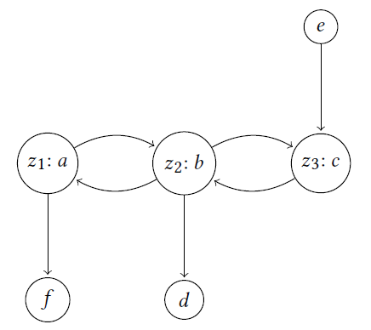
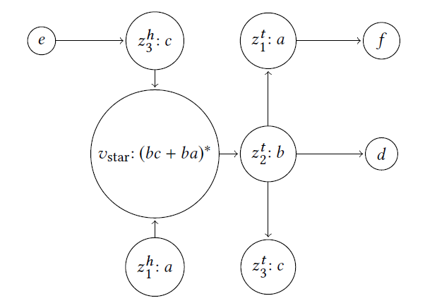
Loop Refinement Procedure
Compute Path-Expression over the resulting DAG
Given ${\left(a_{1}+…+a_{k}\right)}^{∗}$
Create a graph with vertices $\left\{a_{1},…,a_{k}\right\}$
For each pair, $(a_{i},a_{j})$, if $a_{i}⋅a_{j}$ is feasible add edge $(a_{i},a_{j})$
Detect SCCs and capture with a single $∗$

Slide 16
Refining Arbitrary Expressions
GeneralRefinement$(E)$
Recursively calls itself for $+$ and $⋅$ operators
For a $∗$
Take star-body to a sum-of-products
Recursively refine each summand
Syntactically refine the single level loop
Replace refined summands in the refined loop
Theorem 5.2
Let $E^{′}=$GeneralRefinement$(E)$
Then $L\left(E^{′}\right)⊆L(E)$ and $E^{′}≤_{PKA}E$

Slide 17
Experimental Results
State of the Art Model Checkers
Kincaid, Cyphert, Breck, Reps
Non-Linear Reasoning for Invariant synthesis
Not a PKA
Ancourt, Coelho, Irigoin
A Modular Static Analysis Approach to Affine Loop Invariants Detection
A PKA
Summary:
25% more assertions proved with refinement
50% increase in analysis time
Time in seconds
Assertions Proved
Programs with true assertions

Slide 18
Conclusion
Algebra for understanding analysis precision
Pre-Kleene Algebra
An algorithm for control-flow refinement
$R^{′}$ is equivalent to $R$ modulo ℇ
${L(R}^{′})⊆L(R)$
$R^{′}≤_{PKA}R$ (٭)
25% more assertions
50% increase in analysis time
Thank you for your time

